Slide 1

Project Title: Anomaly Detection in IoT Networks
Team Members : 1. Lalitha Priya Bijja – 101168225 2. Venkata Surya Deepak Lakshimpalli - 101143451

Slide 2
Motivation
Anomaly detection in cybersecurity, particularly for IoT devices, is crucial due to increased interconnectedness and threat landscape.
The IoT-23 dataset from the Stratosphere Laboratory enables exploration of anomaly detection challenges in IoT networks.
Research focuses on "Machine Learning and Deep Learning Methods for Better Anomaly Detection in IoT-23 Dataset Cybersecurity."
Proposed model integrates ML/DL methods like Naïve Bayes, SVM, Decision Trees, and CNN for anomaly detection.
Objective: Enhance efficiency and accuracy in detecting anomalies within IoT network traffic.

Slide 3
Problem formulation
Anomaly detection helps identify and prevent malicious activities within IoT networks by distinguishing normal network traffic patterns from abnormal ones.
We explored a hybrid approach combining convolutional neural networks (CNN), support vector machines (SVM), decision trees, and naïve Bayes classifiers for anomaly detection in IoT-23 dataset cybersecurity. Each model will be tailored and optimized for the specific characteristics of IoT network traffic. Dataset: https://mcfp.felk.cvut.cz/publicDatasets/IoT-23-Dataset/iot_23_datasets_small.tar.gz (8.8 GB - lighter version)

Slide 4
Approach
Data Preprocessing :
Loaded 23 datasets separately into Pandas dataframe.
Skipped the first 10 rows (headers) and load the 100,000 rows after.
Combined 23 dataframes into a new dataset: iot23_combined.csv
Preprocessing includes handling missing values, feature normalization, and relevant feature extraction.
Framework employs ML/DL algorithms for anomaly detection on IoT-23 dataset.
Models used : CNN, SVM, Decision Trees, Naïve Bayes.
CNN captures spatial dependencies in network traffic data.
SVM separates normal and anomalous instances in high-dimensional feature space.
Decision trees and naïve Bayes provide interpretable and probabilistic anomaly scores.
Experiments evaluate individual models and hybrid approach using metrics like accuracy, precision, recall, and F1-score.
Comparative analysis with state-of-the-art methods demonstrates effectiveness.

Slide 5
Results and findings
CNN Model
built Neural Network model using TensorFlow and Keras for classifying IOT network traffic data into different categories based on features such as duration, bytes transferred, packet counts, and connection state. Findings Validation accuracy: ~69.35% after 10 epochs
Training time: ~242.42 seconds
Architecture: Dense layers (2000, 1500, 800, 400, 150), output layer with 12 neurons
Dropout layers added for preventing overfitting
Validation accuracy remains stable across epochs, suggesting room for optimization.

Slide 6
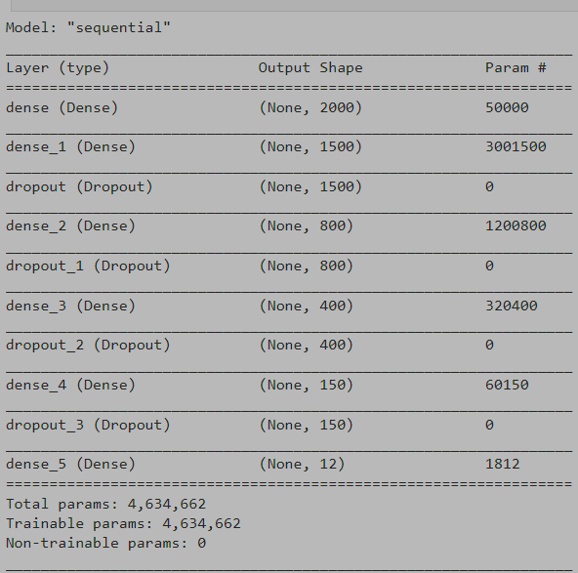
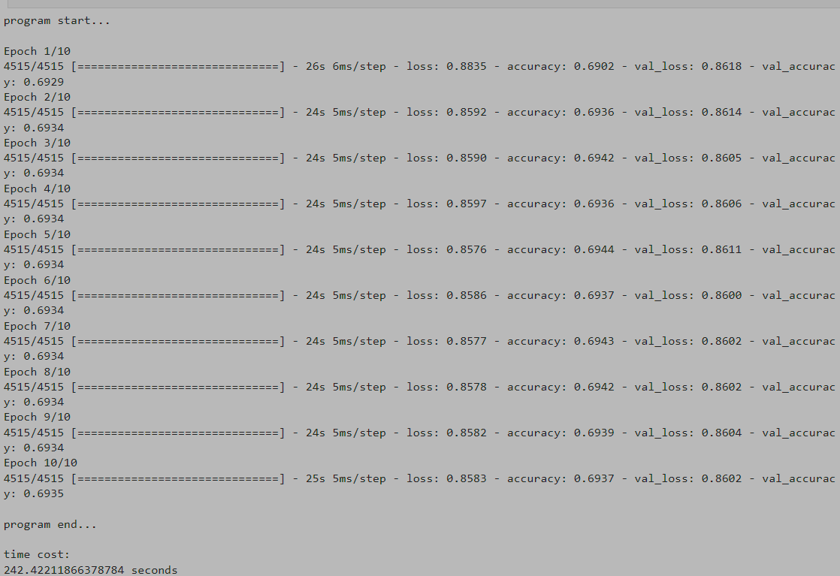
Output :

Slide 7
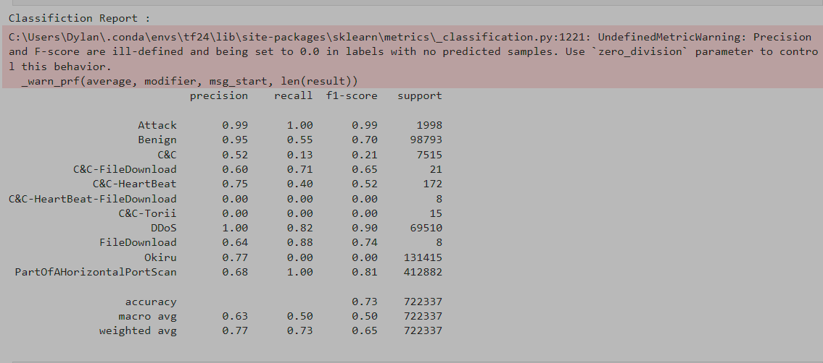
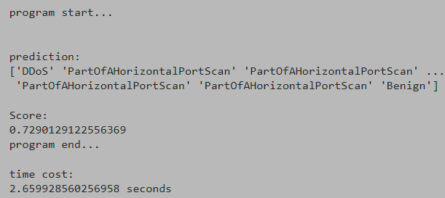
Decision trees
provide interpretable and probabilistic anomaly scores
Output: The overall accuracy of the model is approximately 72.90%.

Slide 8
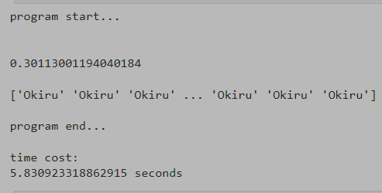
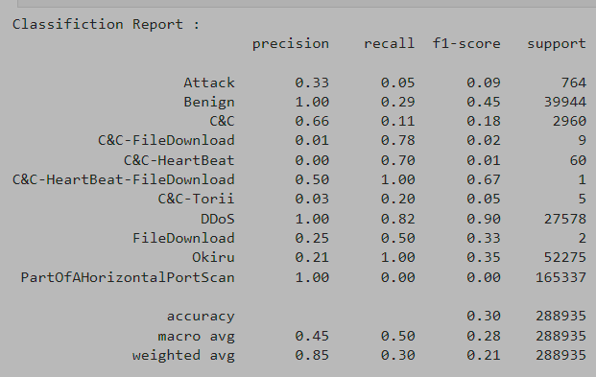
NAÏVE BAYES
Output
Examination of the classification report reveals an overall model accuracy of approximately 30.11%, indicating suboptimal performance in categorizing IoT network traffic.
Detailed inspection of precision, recall, and F1-score values for individual classes highlights the model's challenges in accurately classifying instances across diverse categories.
Notably, significant class imbalances may contribute to the model's underperformance, as indicated by warnings regarding ill-defined precision and recall for certain classes.

Slide 9
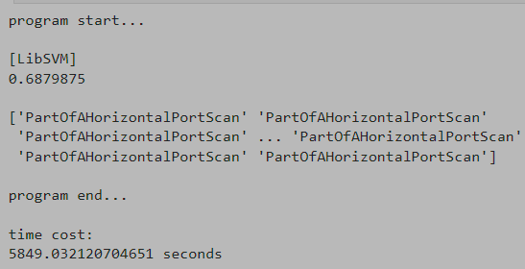
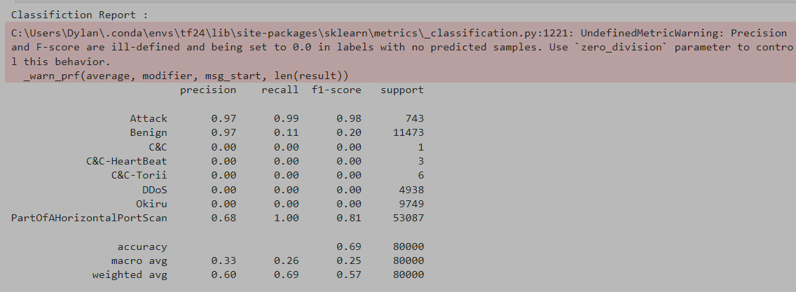
SVM
OUTPUTS
This model will focused on separating normal and anomalous instances in a high-dimensional feature space. Outputs
Findings
SVM classifier achieves ~68.8% accuracy on the test set.
Performance varies across classes:
'Attack' and 'PartOfAHorizontalPortScan' show high precision, recall, and F1-score.
'Benign' and 'Okiru' display low precision and recall.
Classes with few samples lead to undefined metrics (precision, F1-score) due to limited data.
Training and evaluation take ~5849 seconds, potentially due to dataset size or model complexity.

Slide 10
conclusion
Neural Network (NN):
Achieved an accuracy of ~69.35% on the validation set.
Model architecture with dense layers.
Relatively stable accuracy throughout epochs.
Training time: ~242.42 seconds.
Decision Tree (DT):
Attained an accuracy of ~72.9% on the test set.
Decision tree classifier used.
Notable imbalances in precision and recall across classes.
Training time: ~2.66 seconds.
Gaussian Naive Bayes (GNB):
Obtained an accuracy of ~30.11% on the test set.
Gaussian Naive Bayes classifier employed.
Severe issues with precision and recall across most classes.
Training time: ~5.83 seconds.

Slide 11
continued
Support Vector Machine (SVM):
Achieved an accuracy of ~68.8% on the test set.
SVM classifier utilized.
Varied performance across classes, with notable precision and recall for certain classes.
Training time: ~5849 seconds.
Final Conclusion Decision tree model achieved highest accuracy, closely followed by neural network.
Decision tree model exhibited precision and recall issues, signaling room for improvement.
Gaussian Naive Bayes model performed the poorest due to simplifying assumptions.
SVM model showed competitive accuracy despite longer training time and class-specific performance issues.
Further refinement and optimization needed for all models to enhance accuracy and address class imbalances effectively.
Decision tree model strikes a balance between accuracy and efficiency, considering computational resources.

Slide 13
Thank you

